Slide 1
course registration database.
Shansi Dong
A20466369

Slide 2
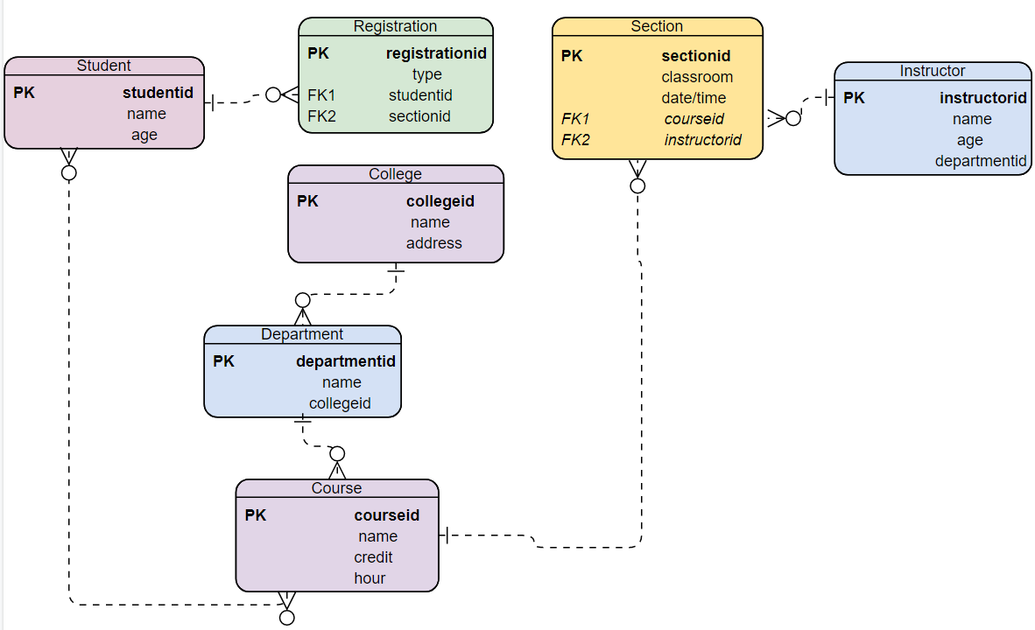

Slide 3
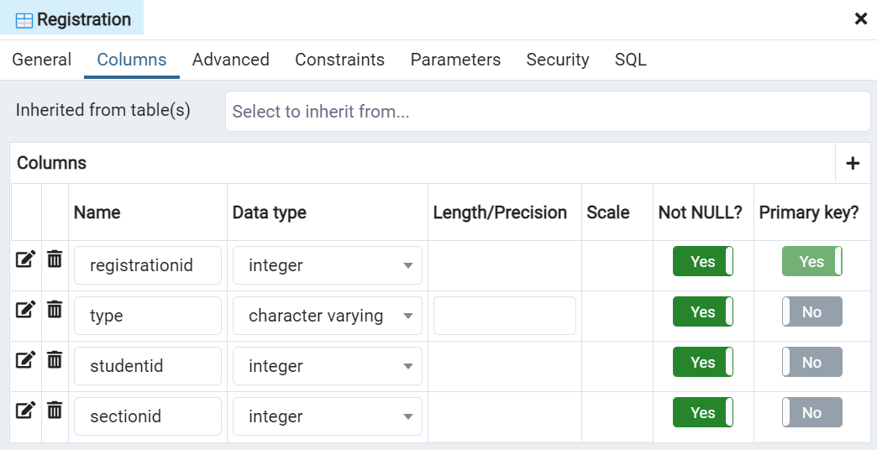

Slide 4
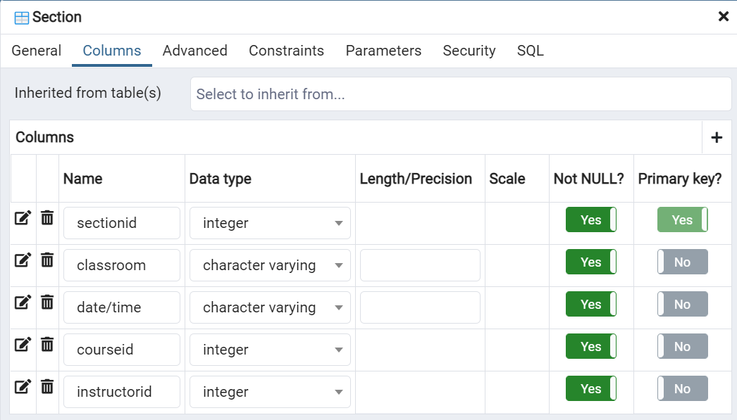

Slide 5
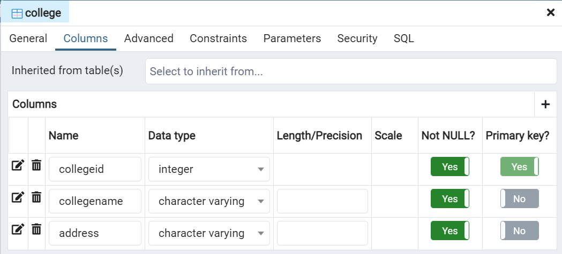
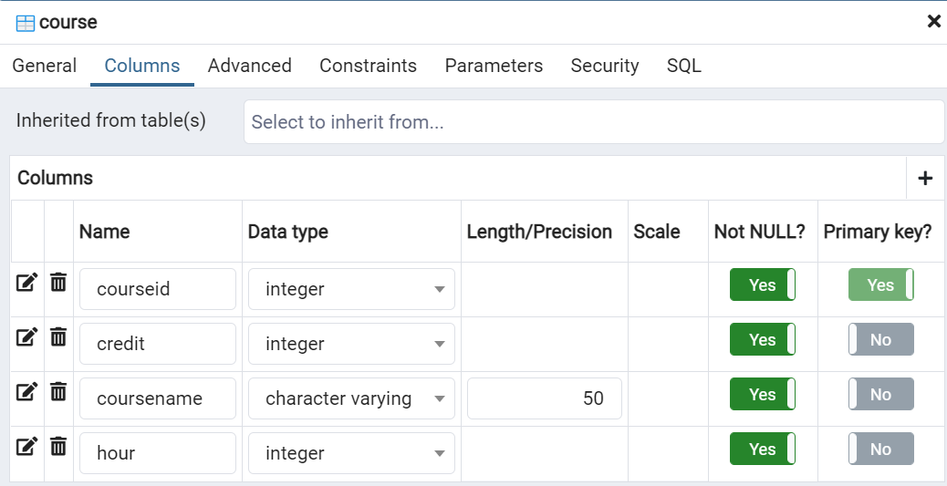

Slide 6
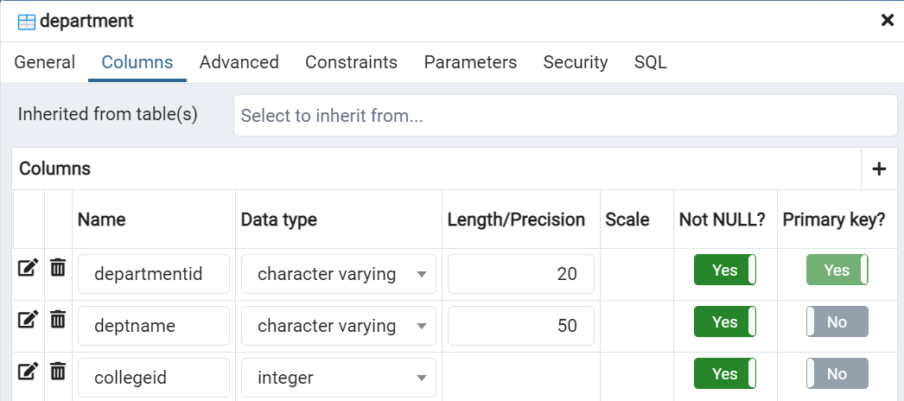

Slide 7
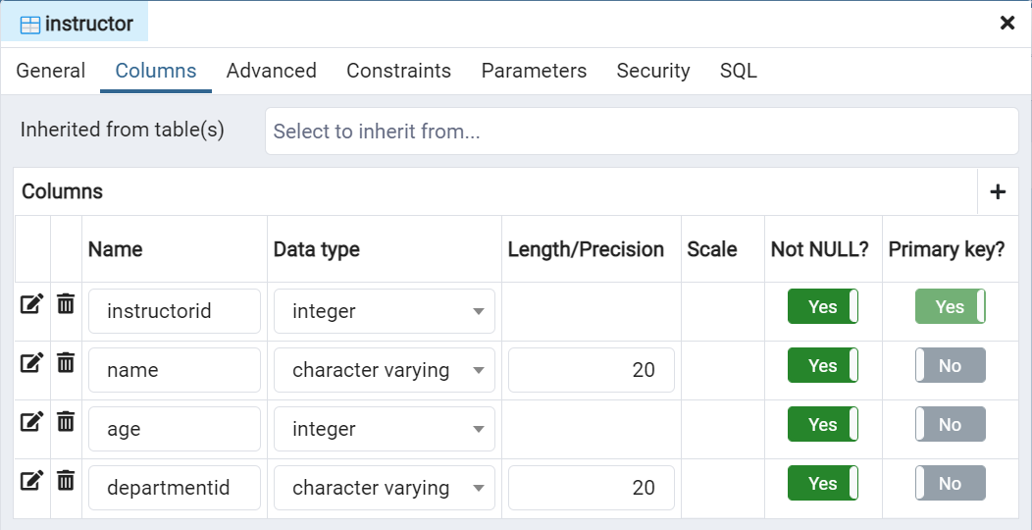

Slide 8
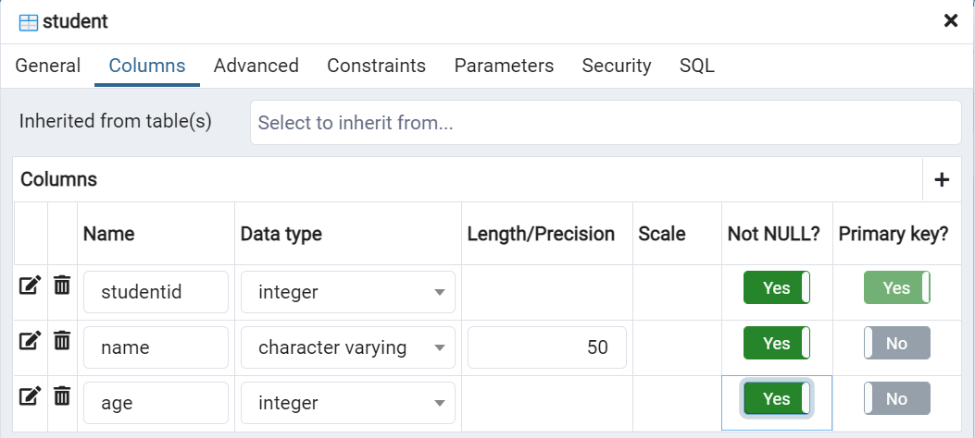

Slide 9
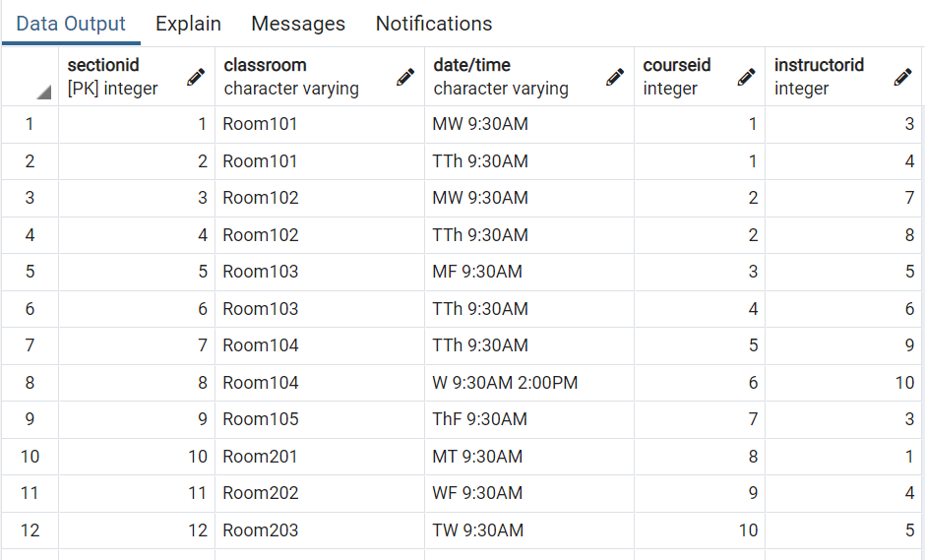
Insert value in table “section’’:
INSERT INTO public."Section"(
sectionid, classroom, "date/time", courseid, instructorid)
VALUES (1, 'Room101','MW 9:30AM',1,3),
(2, 'Room101','TTh 9:30AM',1,4),
(3, 'Room102','MW 9:30AM',2,7),
(4, 'Room102','TTh 9:30AM',2,8),
(5, 'Room103','MF 9:30AM',3,5),
(6, 'Room103','TTh 9:30AM',4,6),
(7, 'Room104','TTh 9:30AM',5,9),
(8, 'Room104','WF 9:30AM',6,10),
(9, 'Room105','ThF 9:30AM',7,3),
(10, 'Room201','MT 9:30AM',8,1),
(11, 'Room202','WF 9:30AM',9,4),
(12, 'Room203','TW 9:30AM',10,5);

Slide 10
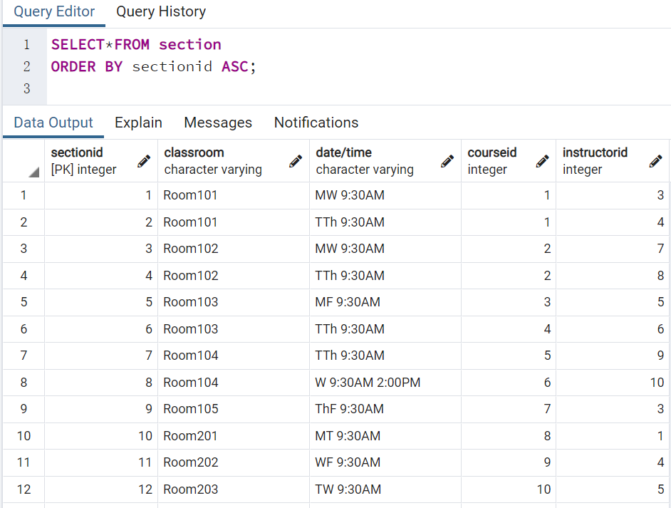
SELECT*FROM section ORDER BY sectionid ASC;

Slide 11
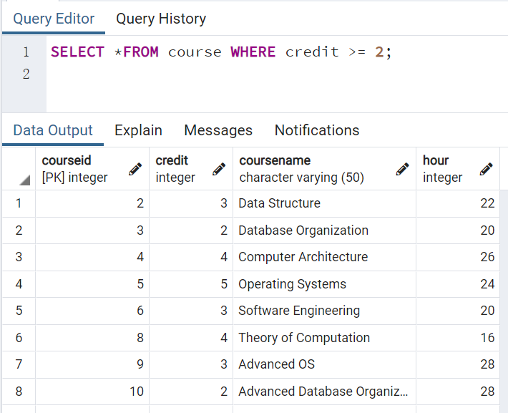
SELECT *FROM course WHERE credits >= 2;

Slide 12
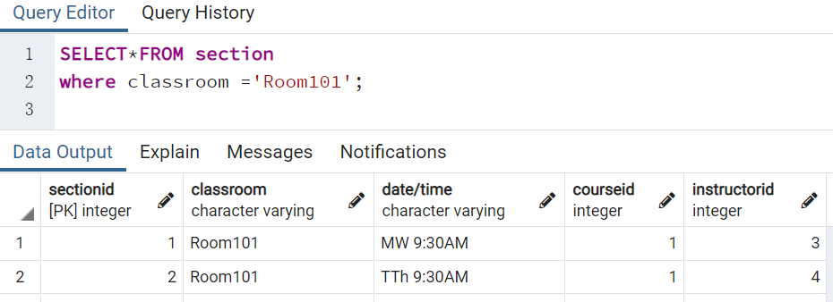
SELECT*FROM section where classroom ='Room101';

Slide 13
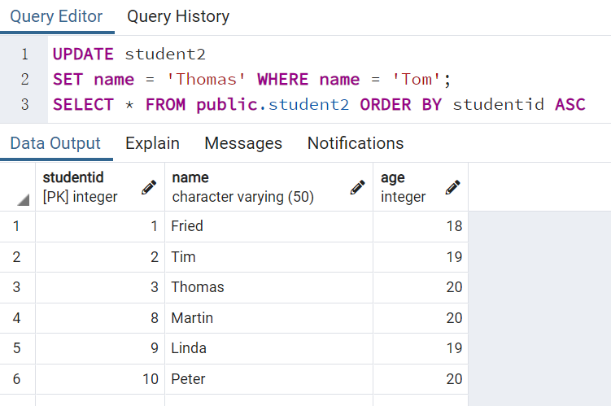
UPDATE student2
SET name = 'Thomas' WHERE name = 'Tom';
SELECT * FROM public.student2 ORDER BY studentid ASC

Slide 14
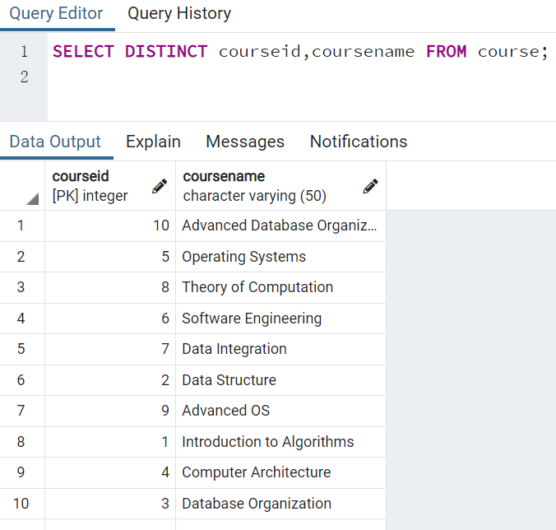
SELECT DISTINCT courseid,coursename FROM course;

Slide 15
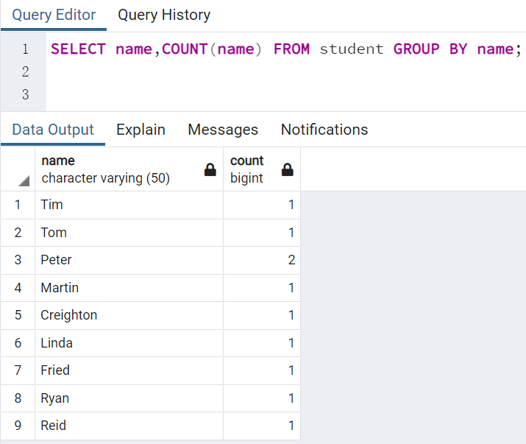
SELECT name,COUNT(name) FROM student GROUP BY name;

Slide 16
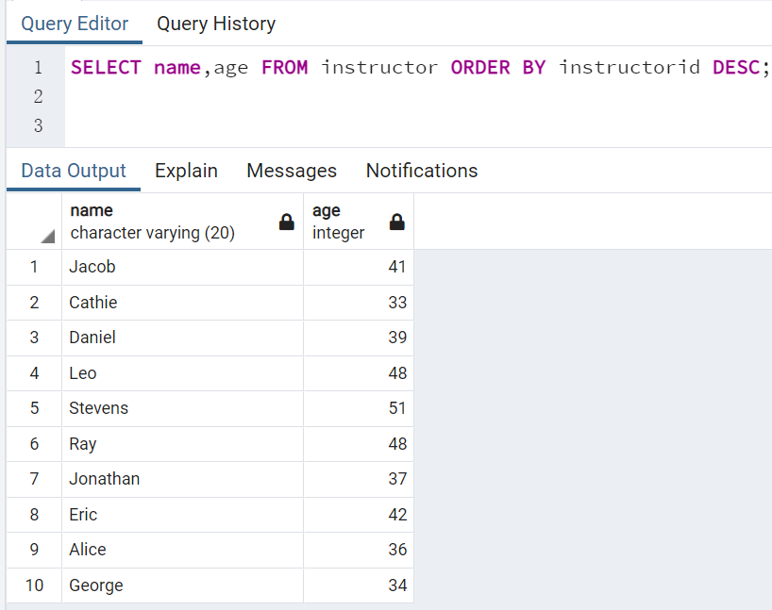
SELECT name,age FROM instructor ORDER BY instructorid DESC;

Slide 17
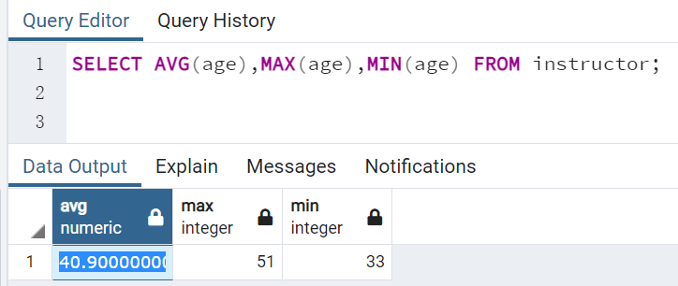
SELECT AVG(age),MAX(age),MIN(age) FROM instructor;

Slide 18
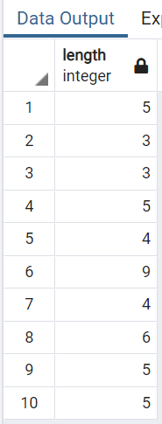
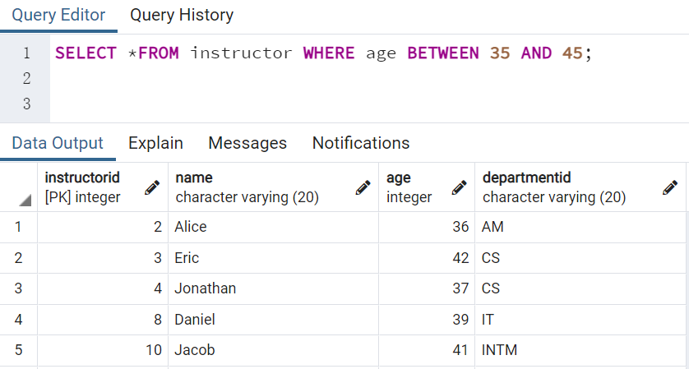
select length(name) from student；
SELECT *FROM instructor WHERE age BETWEEN 35 AND 45;

Slide 19
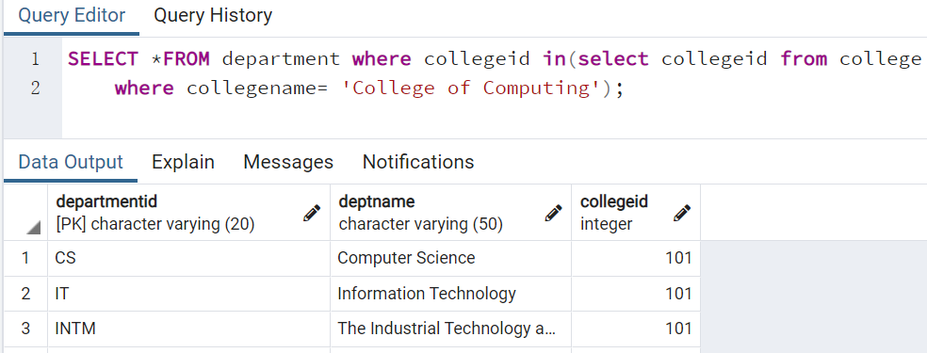
What are all the departments from College of Computing?
SELECT *FROM department where collegeid in(select collegeid from college
where collegename= 'College of Computing');

Slide 20
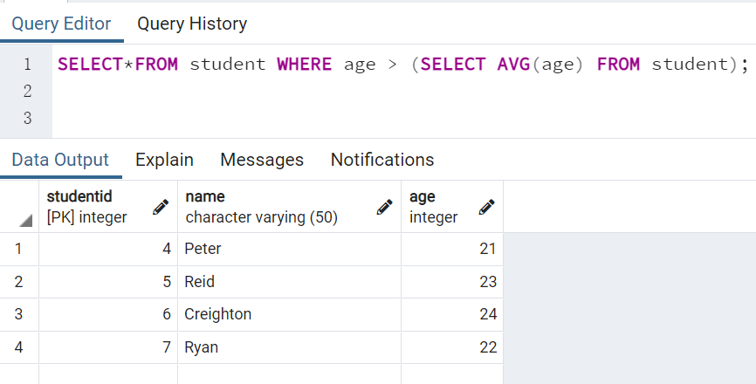
Using a subquery, list all the students with ages above the average.
SELECT *FROM student where age>(select AVG(age) from student);

Slide 21
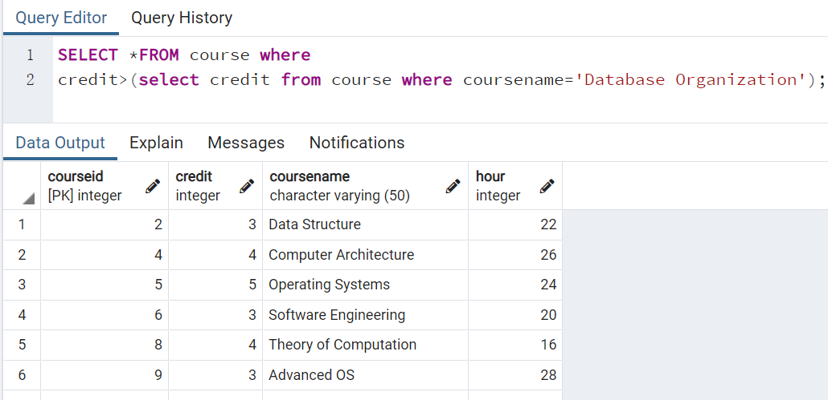
Using a subquery, list courses with credits larger than Database Organization.
SELECT *FROM course where
credit>(select credit from course where coursename='Database Organization');

Slide 22
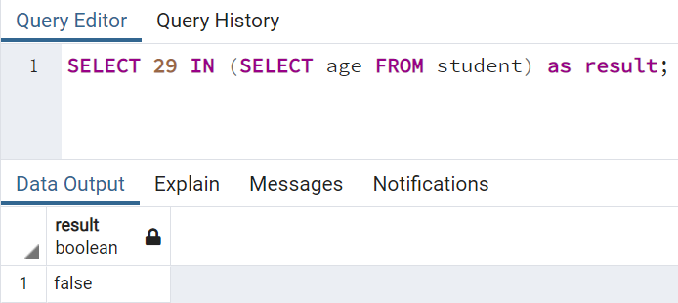
Using a subquery, to see if a student ages 29 exists within the student table:
SELECT 29 in (select age from student) as result;

Slide 23
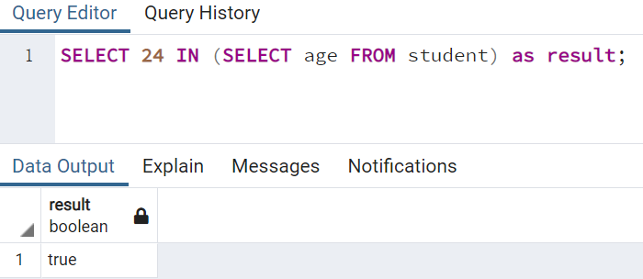
Using a subquery, to see if a student ages 24 exists within the student table:
SELECT 24 in (select age from student) as result;

Slide 24
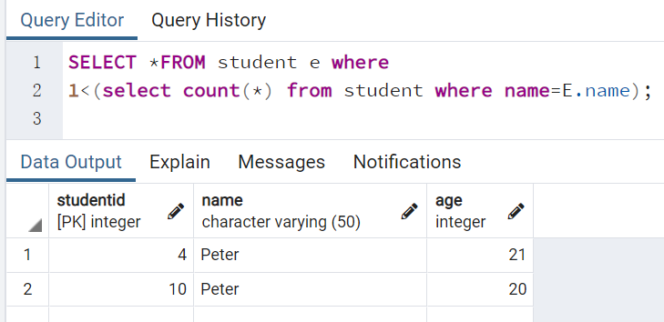
Using a subquery, to check if 2 or more students have the same name.
SELECT *FROM student e where
1<(select count(*) from student where name=E.name);

Slide 25
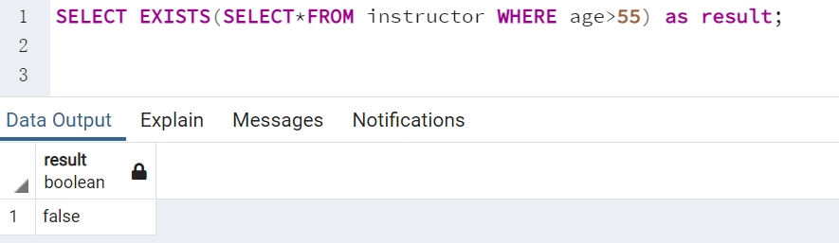
Using a subquery, to see if there’re any instructors with ages above 55 exist.
SELECT EXISTS(SELECT*FROM instructor where age>55) as result;

Slide 26
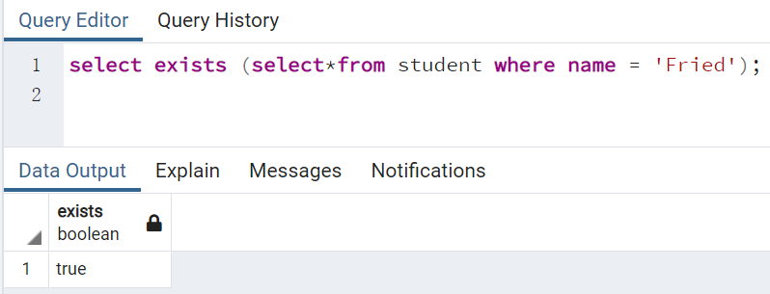
Using a subquery, to see if there’re any instructors with name Fried exist.
SELECT EXISTS(SELECT*FROM student where name = 'Fried') as result;

Slide 27
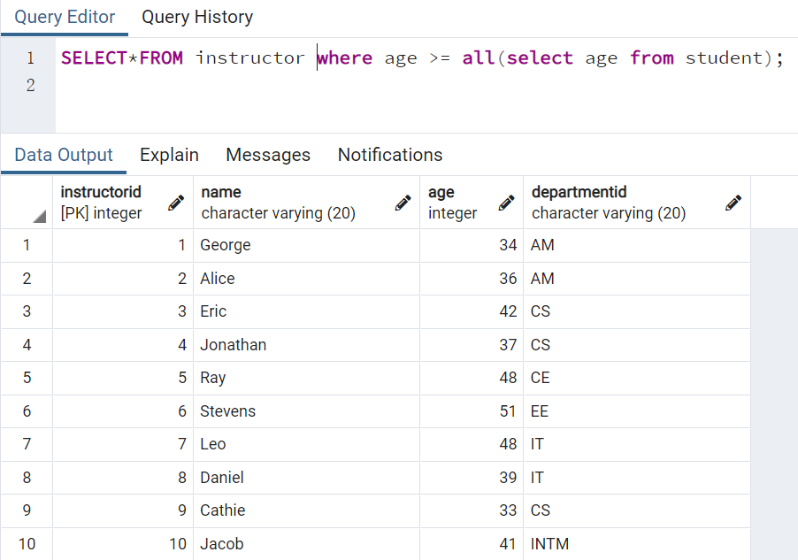
Using a subquery, list all the instructors whose ages above all students’ ages.
SELECT*FROM instructor where age >= all(select age from student);

Slide 28
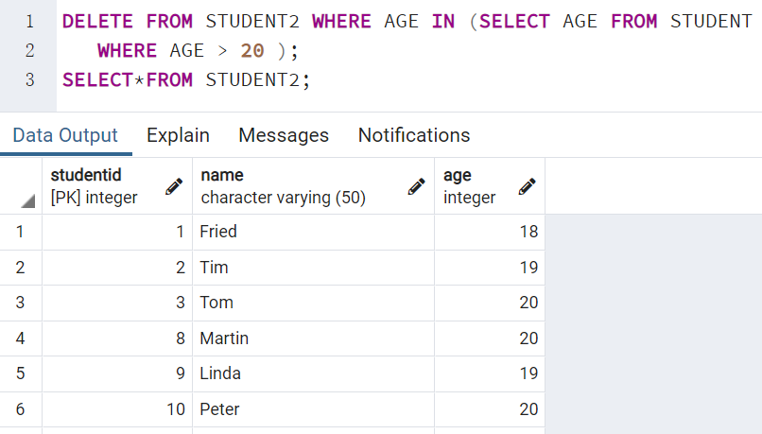
Using a subquery, delete all the students with ages above 20 from student2(which is a copy of table student)
DELETE*FROM STUDENT2 WHERE AGE IN (select age from student WHERE AGE >20);
SELECT*FROM STUDENT2;

